Slide 1
Class 7: Graph Neural Networks for Weather Forecasting

Slide 2

Outline
Motivation & recap of sequence models
Graph basics & adjacency matrices
GCN propagation rule & numeric example
Message passing intuition
Graph Attention (GAT) & example
Weather data & graph construction
Sequence preparation
Manual & framework implementations
Variants & extensions
Practical tips, applications & summary

Slide 3
Motivation & Recap: why graphs?
Sequence models (LSTMs, Transformers) capture temporal patterns but ignore spatial relationships among distributed sensors.
Weather stations form an irregular network where nearby stations influence each other more than distant ones.
Graph Neural Networks jointly learn from node features and edge structure to model spatial correlations.
 | Sequence Models | Graph Models
Structure | Linear (time) | Irregular (nodes & edges)
Dependencies | Temporal only | Spatial & temporal
Applications | Time‑series forecasting | Networks: social, transport, weather

Slide 4
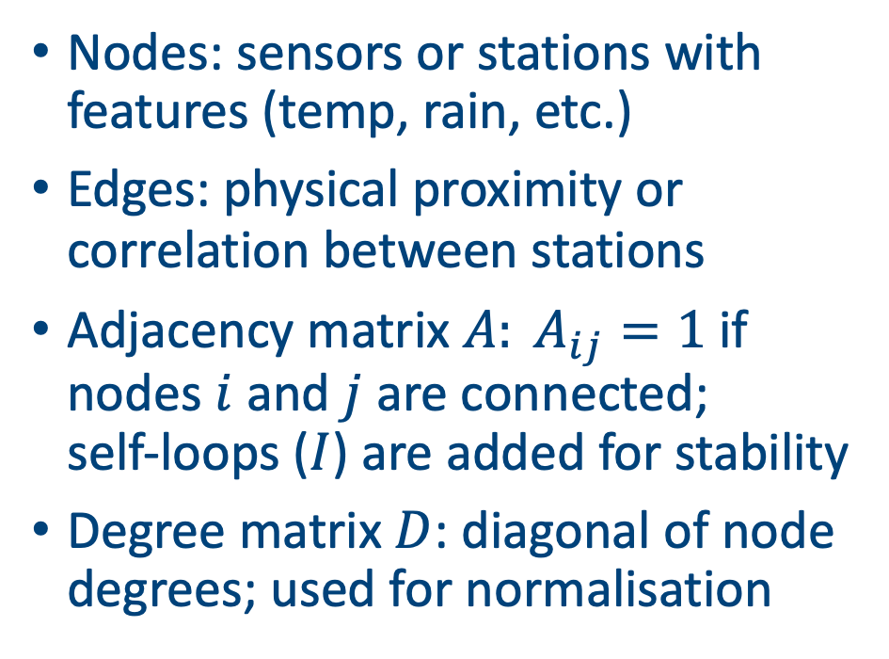
Graph basics
Nodes: sensors or stations with features (temp, rain, etc.)
Edges: physical proximity or correlation between stations
Adjacency matrix $A: A_{ij}=1$if nodes $i$ and $j$ are connected; self‑loops ($I$) are added for stability
Degree matrix $D$: diagonal of node degrees; used for normalisation
 | v0 | v1 | v2
v0 | 1 | 1 | 0
v1 | 1 | 1 | 1
v2 | 0 | 1 | 1
v1
Degree = 3
v0
v2
Degree = 2
Degree = 2

Slide 5
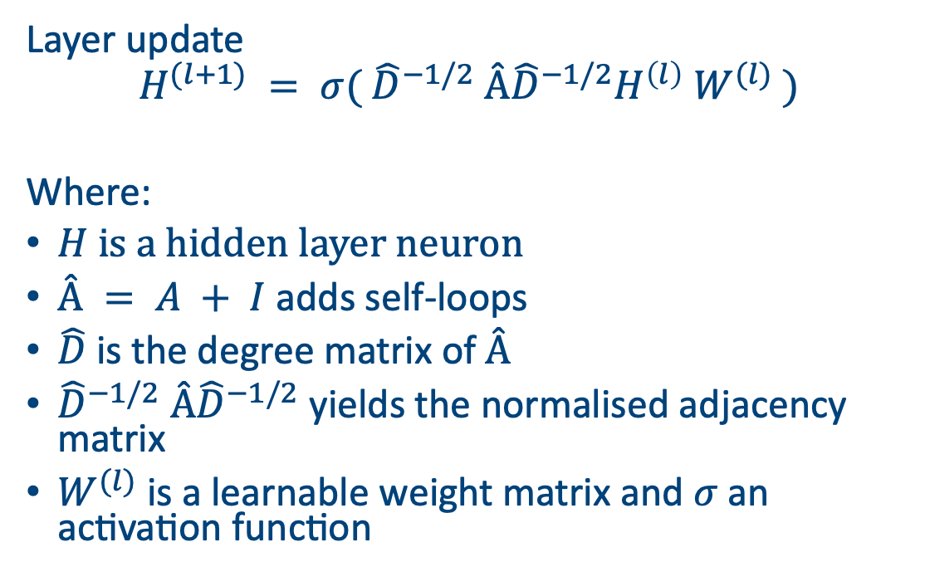
Graph propagation rule
Layer update
$$H^{(l+1)} = σ( {\hat{D}}^{−1/2} Â{\hat{D}}^{−1/2}H^{\left(l\right)} W^{(l)} )$$
Where:
$H$ is a hidden layer neuron
$Â = A + I$adds self‑loops
$\hat{D}$ is the degree matrix of $Â$
${\hat{D}}^{−1/2} Â{\hat{D}}^{−1/2}$ yields the normalised adjacency matrix
$W^{(l)}$ is a learnable weight matrix and $σ$ an activation function

Slide 6
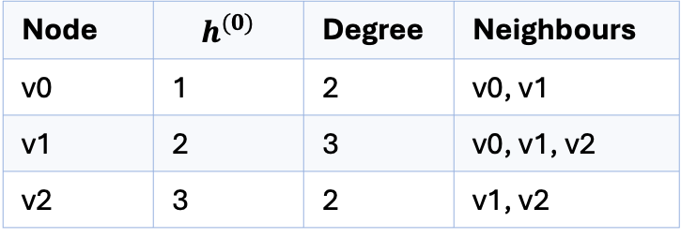

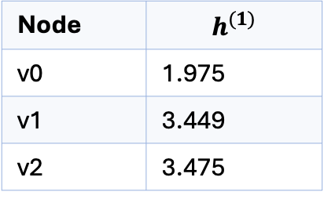
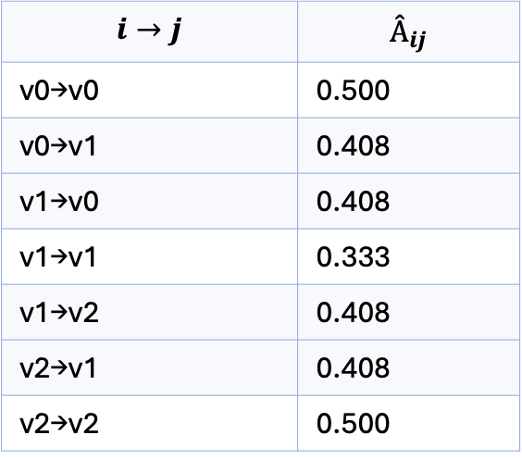
GNN example
Steps
Compute degree & neighbours
Normalise $A$ using${\hat{D}}^{−1/2} Â{\hat{D}}^{−1/2}$
Aggregate neighbour features and multiply by $W$
Node | $$h^{(0)}$$ | Degree | Neighbours
v0 | 1 | 2 | v0, v1
v1 | 2 | 3 | v0, v1, v2
v2 | 3 | 2 | v1, v2
$$i→j$$ | $$Â_{ij}$$
v0→v0 | 0.500
v0→v1 | 0.408
v1→v0 | 0.408
v1→v1 | 0.333
v1→v2 | 0.408
v2→v1 | 0.408
v2→v2 | 0.500
Node | $$h^{(1)}$$
v0 | 1.975
v1 | 3.449
v2 | 3.475

Slide 7
Message Passing and Intuition
Each node collects messages from its neighbours and combines them.
Messages are weighted (by normalised adjacency or attention) and passed through a learnable transform.
Repeating this across layers allows information to propagate to distant nodes.
v1
v0
v2

Slide 8
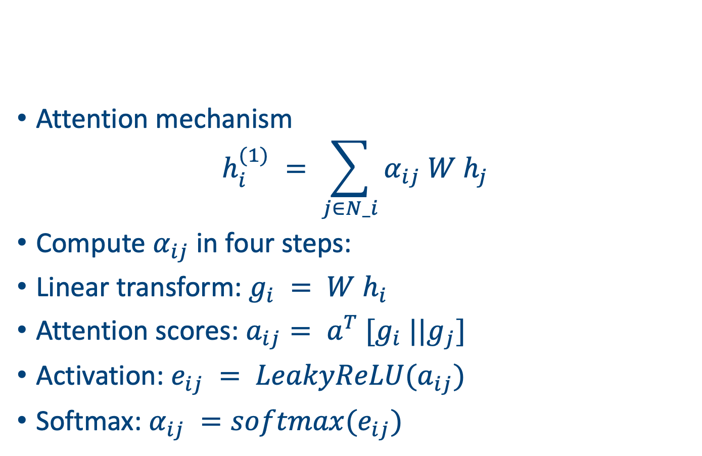
Graph Attention Networks
Attention mechanism
$$h_{i}^{(1)} = \sum_{j∈N_i}{α_{ij} W h_{j}}$$
Compute $α_{ij}$in four steps:
Linear transform: $g_{i} = W h_{i}$
Attention scores: $a_{ij}= a^{T} [g_{i} ||g_{j}]$
Activation: $e_{ij} = LeakyReLU(a_{ij})$
Softmax: $α_{ij} =softmax(e_{ij})$

Slide 9

GAT example
$α_{ij}$shows the importance of neighbour $j$ to node $i$.
Weighted sum produces new feature $h_{i}^{(1)}$.
Attention allows the model to focus on influential neighbours.
Node | Neighbours | Weights α_{ij} | h^{(1)}
v0 | v0, v1 | 0.378, 0.622 | 1.622
v1 | v0, v1, v2 | 0.186, 0.307, 0.506 | 2.320
v2 | v1, v2 | 0.378, 0.622 | 2.622

Slide 10
GAT for Weather Applications
Each station records multiple variables over time (temp, rain, humidity).
Edges capture spatial relations: adjacency can be based on geographic distance or correlation.
Goal: predict next‑day weather for each station using past observations and graph structure.

Slide 11
Graph construction
Nodes correspond to stations
Edges connect nearby stations (e.g., B connected to A and C)
Self‑loops added (diagonal 1s) for feature retention
Station | A | B | C
A | 1 | 1 | 0
B | 1 | 1 | 1
C | 0 | 1 | 1

Slide 12
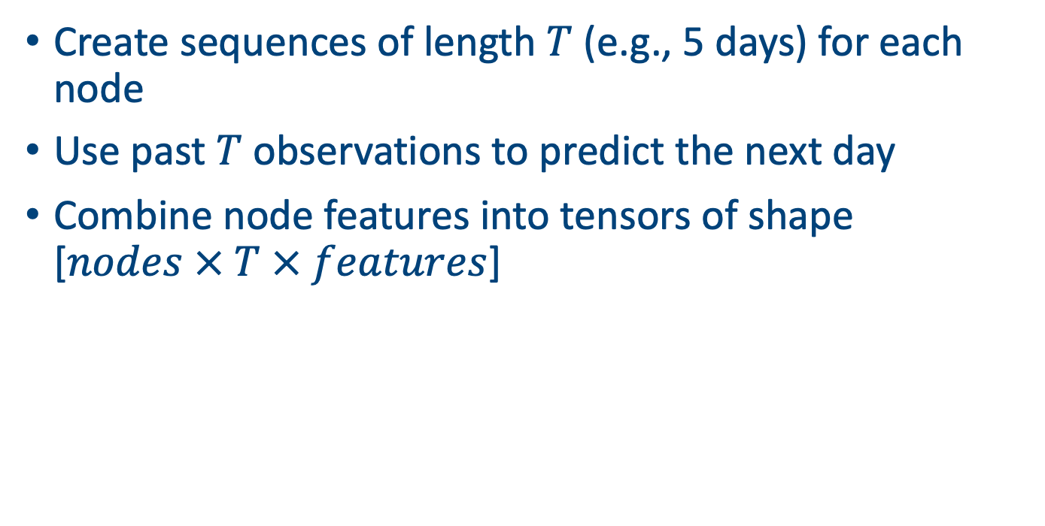
Sliding windows
Create sequences of length $T$ (e.g., 5 days) for each node
Use past $T$ observations to predict the next day
Combine node features into tensors of shape [$nodes × T × features$]
t-4
t-3
t-2
t-1
t+1

Slide 13
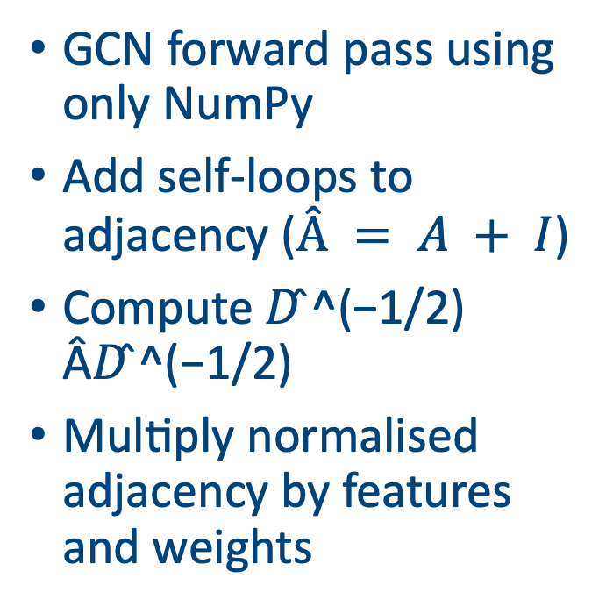
Manual implementation – forward pass
GCN forward pass using only NumPy
Add self‑loops to adjacency ($Â = A + I$)
Compute 𝐷 ̂^(−1/2) Â𝐷 ̂^(−1/2)
Multiply normalised adjacency by features and weights
import numpy as np
A = np.array([[1,1,0],[1,1,1],[0,1,1]])
I = np.eye(3)
A_hat = A + I
# Degree matrix
D = np.diag(np.sum(A_hat, axis=1))
D_inv_sqrt = np.linalg.inv(np.sqrt(D))
A_norm = D_inv_sqrt @ A_hat @ D_inv_sqrt
H0 = np.array([[1],[2],[3]])
W = np.array([[1.5]])
H1 = A_norm @ H0 @ W
print(H1)

Slide 14
Pytorch implementation
Use PyTorch Geometric or DGL for efficient sparse operations.
Combine GCN and GAT layers to capture smooth and attention‑based interactions.
Train with Adam optimiser and monitor validation metrics.
import torch
from torch_geometric.nn import GCNConv, GATConv
class GNN(torch.nn.Module):
def __init__(self):
super().__init__()
self.conv1 = GCNConv(in_channels=3, out_channels=16)
self.attn = GATConv(16, 8, heads=2)
self.fc = torch.nn.Linear(16, 1)
def forward(self, x, edge_index):
x = torch.relu(self.conv1(x, edge_index))
x = torch.relu(self.attn(x, edge_index))
return self.fc(x)

Slide 15
Pytorch Results

Slide 16
Hyper-parameter tuning
Model choices
Number of layers (depth)
Hidden dimensions per layer
Aggregation type (mean, sum, max)
Attention heads (for GAT)
Dropout rate & learning rate

Slide 17
Variants and extensions
GraphSAGE: Samples fixed‑size neighbourhood and aggregates via mean, max, or LSTM
Graph Isomorphism Network (GIN): Uses sum aggregation and learnable ε to increase expressiveness
Pooling & Readout: Global mean, max, or attention pooling summarises node embeddings

Slide 18
Challenges
Advantages
Captures spatial structure of complex systems (roads, power grids, sensor networks)
Supports variable graph sizes and inductive generalisation to new nodes
Reuses weights across locations for parameter efficiency
Challenges
Graph construction: deciding edges and weights
Scalability to large graphs (memory & computation)
Dynamic graphs and time‑varying edges

Slide 19
Practical tips
Preprocessing
Normalise features and scale adjacency weights
Handle missing data by imputation or masking
Choose appropriate window sizes for temporal context
Training
Use mini‑batching with neighbour sampling for large graphs
Monitor validation metrics and avoid overfitting
Leverage GPUs and sparse operations for efficiency

Slide 20
Summary
GNNs generalise neural networks to irregular graph structures
GCN layers normalise adjacency and aggregate neighbour features
GAT layers assign dynamic importance to neighbours via attention
Weather forecasting benefits from capturing spatial relationships
Frameworks like PyTorch Geometric make implementation practical

